Slide 1
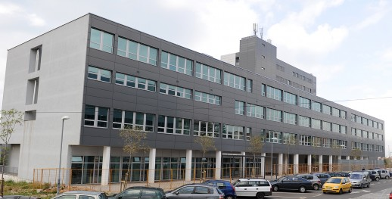
A migration from conventional LMS to a cloud-based learning platform
Odjel za informatiku, Sveučilište u Rijeci
Omladinska 14, 51000 Rijeka, Hrvatska
Tel.: + 385 51 345 046 Fax: + 385 51 344 100
http://www.inf.uniri.hr
Nataša Hoić-Božić, Ema Kušen
Division of multimedia systems and e-learning

Slide 2
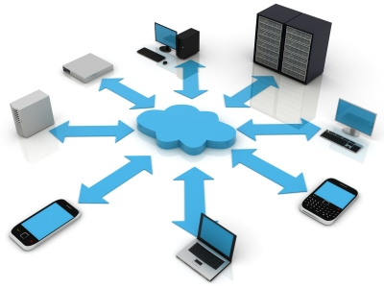
Introduction
Content-centric course design approach and standard LMS are no longer meeting the student preferences and need
Work-in-progress with the aim to identify cloud- based learning platforms as motivating tool for students at the Department of Informatics
Possible migration from Moodle LMS to Instructure Canvas system

Slide 3

Traditional e-learninig
Learning Managment System (LMS) or Virtual Learning Environment (VLE)
Content-centered instead of student-centered approach
Typical actions:
  learning from online materials,
  taking online quizzes,
  handing in homework solutions and projects,
  communicating with the instructor

Slide 4













Personal learning environments (PLE)
Tools, communities, and services that help students manage their own learning
Web 2.0 tools allow students to create, share, publish and collaborate over the Internet
Cloud computing technologies

Slide 5
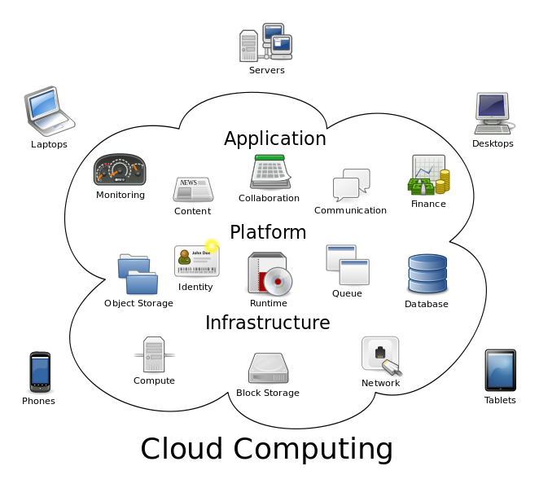
Cloud computing
Computation paradigm in which the resources of an IT system are offered as services in a flexible way over the Internet
Users can access services in real time without interacting with service’s provider
Services are delivered in a “pay-as-you-go” model

Slide 6
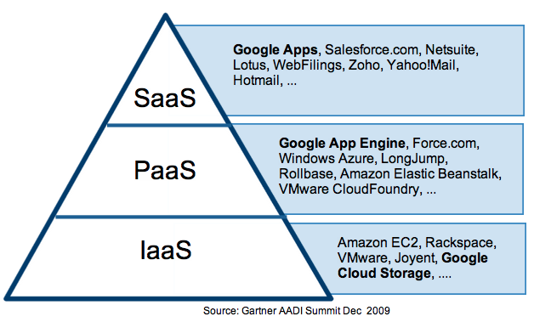
Cloud computing layers
Infrastructure as a service (IaaS): network, servers, storage, …
Platform as a service (PaaS): tools for creating users’ programs
Software as a service (SaaS): complete user applications accessed from cloud

Slide 7
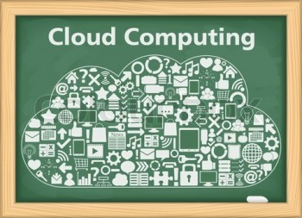
Cloud computing advantages in education
24/7 access to applications, infrastructure and content from anywhere
Simplified software installation, centralized control, and simplified maintenance
Low-cost or free services on demand through browser with various devices (mobile phones, computers, tablets)
Social media services and other Web 2.0 tools through the SaaS

Slide 8
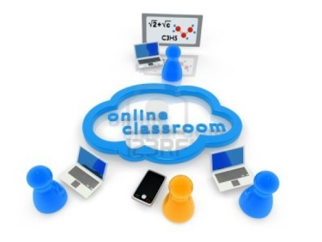
A migration to a learning platform in the cloud
Universities “early adopters” in using cloud computing
Decision to migrate to a LMS in the cloud depends on pedagogical issues:
  different teaching methods and learning styles, various kinds of multimedia content presentation and educational activities (assignments, quizzes, reading course materials, tools for communication, …)
Possible problem: insecurity of users regarding their personal data stored in a cloud

Slide 9
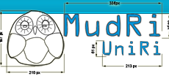
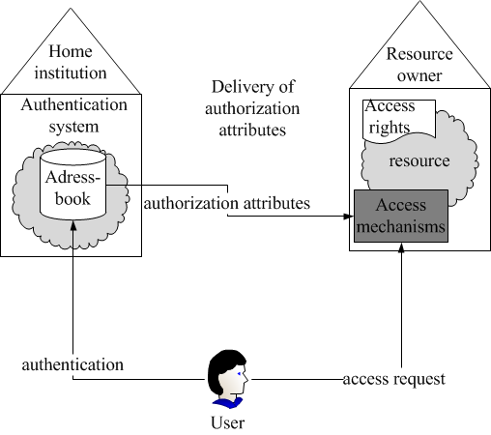
Experiences at UNIRI
E-learning platform: LMS MudRi
Moodle system adapted to the specific needs of UNIRI
Access through authentication and authorization infrastructure identity AAI@Edu

Slide 10

MudRi drawbacks
need for upgrading to up-to-date versions
need for administration and server maintenance
a teacher cannot embed Web 2.0 tools or widgets on his own
a risk of a server crash
a need to handle a high workload
→ a need for a new cloud based LMS occurred

Slide 11

Background
Course Operations Research
In 2012/2013 35 senior students in the first year of graduate program Computer Science
The same group was enrolled in MudRi e-course Multimedia Systems in 2011/2012
f2f course
LMS support by providing course materials, upload homework assignments, keep track of the course grades, post announcements, offer online quizzes for additional points

Slide 12

A five phase migration process
A criterion-based selection of the new LMS
Course import and adjustment
Student registration
Course progress
Course (LMS) evaluation

Slide 13
1. Criterion-based selection of the new LMS
CATEGORIES | SATISFACTION OF CRITERIA
High level of importance
supports designed learning activities supports the following roles – professor, TA and student organization of course topics into blocks a quiz with various question types which is password restricted math equations and formulas hand in a homework assignment, restrict the upload after the deadline clear and easy to use gradebook cost free online help | + + + + + + + + +
Medium level of importance
import a zipped course from MudRi a teacher can embed additional tools into the course | + +
Low level of importance
in the native language local support adjustment to students with special needs | - - -

Slide 14

  Instructure Canvas
Standard LMS features (assignments, gradebook, pages for course content, discussion tool, announcements, quizzes and integrated learning outcomes)
Possibility to include external tools and widgets, i.e. to make the personalized learning environment
Adaptable for accessing from mobile devices such as mobile phones and tablets

Slide 15
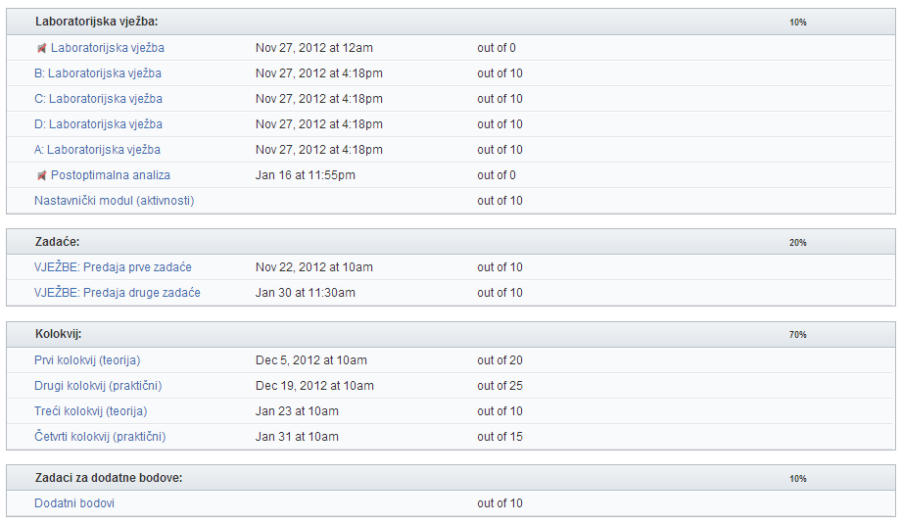
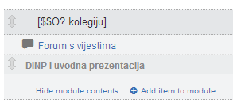
2. Course import and adjustment
Zipped file of the course was imported from MudRi
Course assignments and quizzes were reorganized

Slide 16
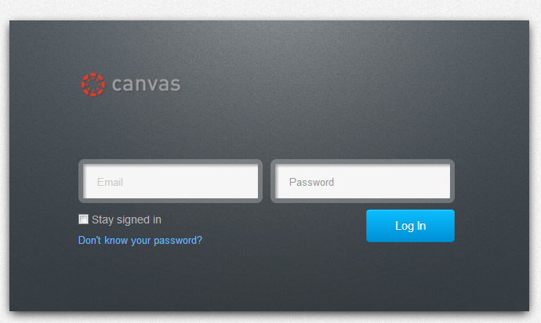
3. Student registration
The enrolment in the course had to be done by the instructor (instead of using AAI@Edu student identity)

Slide 17
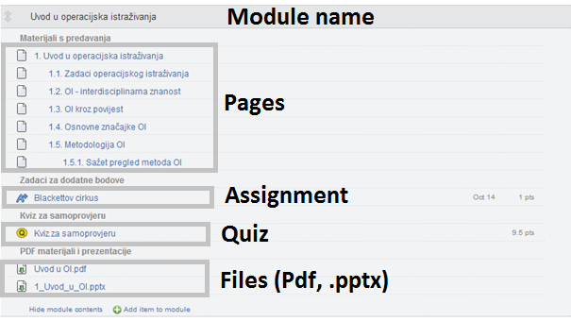
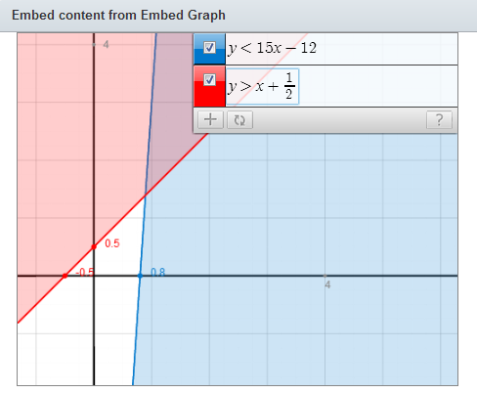
4. Course progress
Course was held traditionally in the classroom
Lecture notes, online quizzes, homework assignments, forum
Graph builder widget for solving homework assignments (a linear programming problem)

Slide 18

5. Course evaluation
Anonymous survey (86% students completed)
  General information about the use of mobile technology in daily life (7 questions)
  Students’ attitudes towards the LMS in cloud (14 Likert scale question)
    three groups of questions: mobility, security and personalization
  Additional comments about the use of the system Instructure Canvas

Slide 19
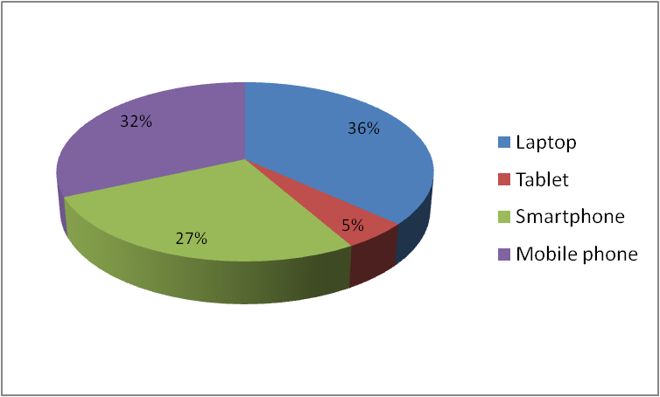
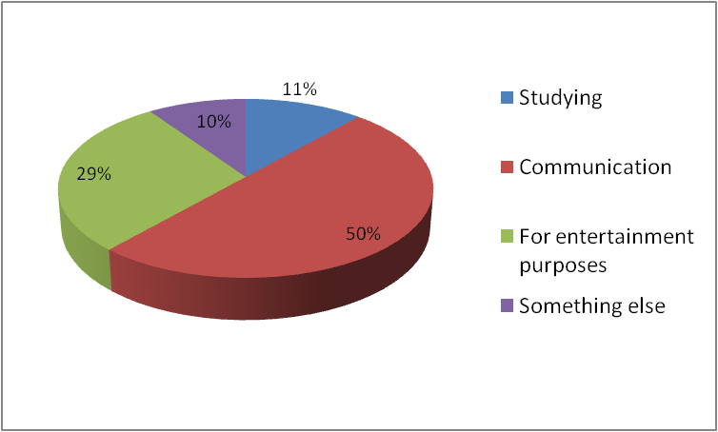
Possession of mobile devices
Purpose of mobile device use
The possession of mobile devices and purpose of using among students

Slide 20
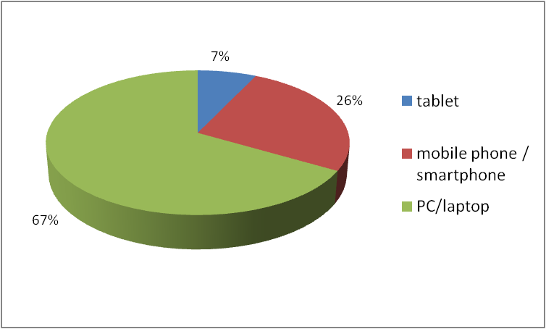
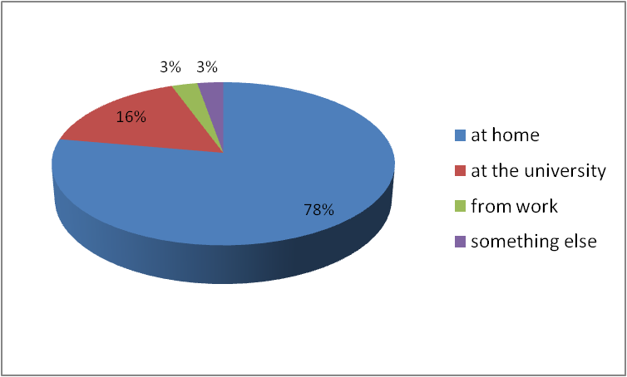
Devices used for accessing Canvas
Access to the Canvas
Devices used and the place where the students access the Instructure Canvas system

Slide 21
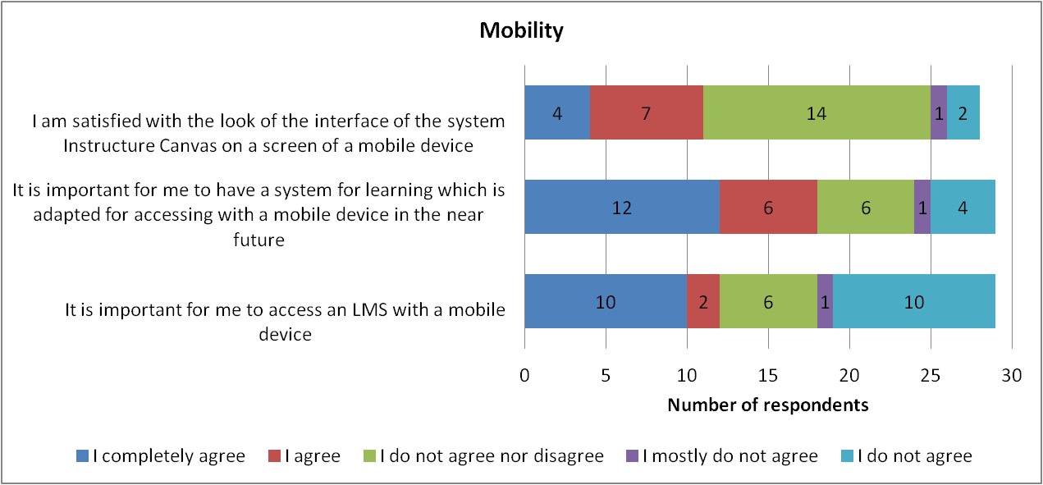
Mobility

Slide 22
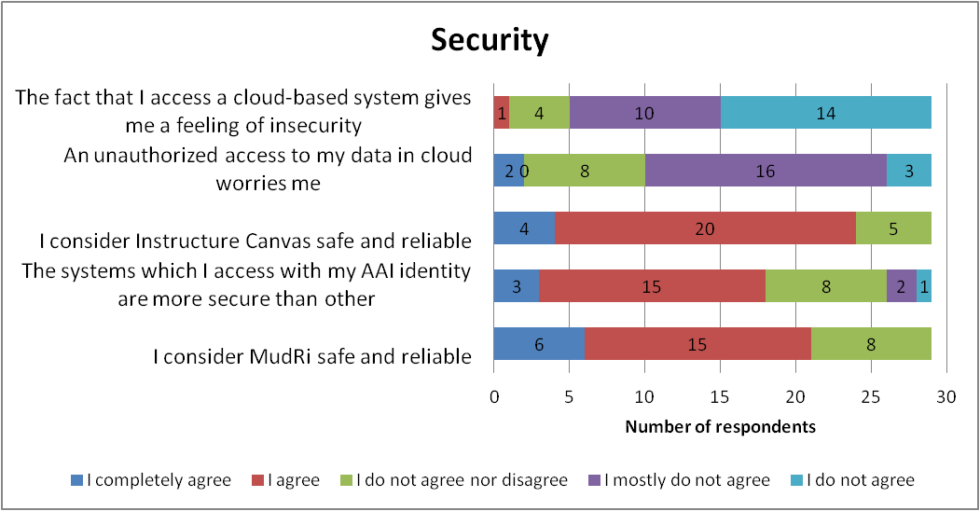
Security

Slide 23
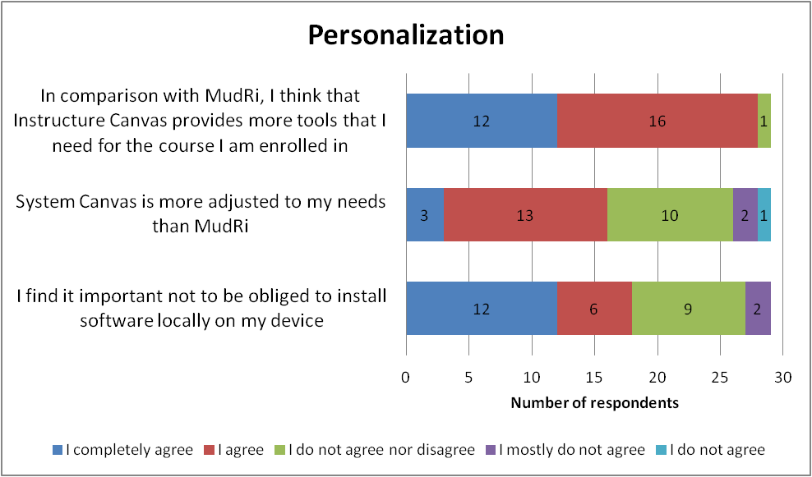
Personalization

Slide 24

Concluding remarks
Cloud-based LMS was well accepted among students
83% of the participants were satisfied with learning in the system Instructure Canvas
Participants in survey did not express feelings of insecurity and discomfort
There is no significant difference in the opinion about the importance of accessing an LMS with a mobile device

Slide 25

Future plans
Importance of accessing an LMS with a mobile device (smartphones, tablets) is still not an issue among our students
From the instructor’s perspective, the migration from Moodle LMS to a cloud-based learning platform could be time-consuming for e-courses with lots of resources and activities
Further examining the cloud-based solutions and potentially incorporate them in some of our courses

Slide 26

Thank you for your attention!
www.inf.uniri.hr
Nataša Hoić-Božić
natasah@inf.uniri.hr

